Slide 1
Expectations of excellence
2025-2026 Academic Year

Slide 2
Coaches
Ashley Kirk-Christman – Alpha Beta Epsilon, Beta Alpha Psi, Kappa Kappa Psi, Tau Beta Sigma
Tori Succi - Alpha Phi Omega, Alpha Zeta Omega, Delta Sigma Pi, Phi Lambda Sigma, Phi Sigma Pi
Jose Garcia - Lambda Kappa Sigma, Gamma Sigma Sigma, Phi Delta Chi, Sigma Theta Alpha
Elizabeth Moy- Sigma Alpha

Slide 3
What is eoe?
& WHAT WILL BE EXPECTED OF PFC ORGANIZATIONS DURING FALL 2025?

Slide 4
Training Requirements
EOE Training (THIS TRAINING)
    President, Vice President
Risk Prevention Training
    President, Vice President, Risk Manager, Social
New Member Education/Intake Training
    President, Vice President, New Member Educator/Intake Coordinator
Philanthropy/Community Service Training
    President, Vice President, Community Service Chair, Philanthropy Chair
SOLID Training (DUE 9/1)

Slide 5
Meeting Requirements
Community Retreat
    President (August 24, 2025)
Mid-Semester Check-In with Chapter Coach
    Between October 15 and November 15
End-of-Semester Check-In with Chapter Coach
    Between December 15 and January 15

Slide 6
Paperwork Requirements
New Member Ed Paperwork
Chapter Information Update (Due 9/14)
UConntact Roster Updates
    Mid-Semester (after bringing in new members)
    End of Semester (12/5)

Slide 7
New Member Education
Paperwork
Meetings & Trainings
Request for Intake/NME
    DUE 2 WEEKS BEFORE START
New Member Report
    DUE 2 DAYS AFTER INVITE/BID AND BEFORE EDUCATION STARTS
Post-Initiation Report
    TASK APART OF NM REPORT
    DUE WITHIN 1 WEEK OF INITIATION
UConntact Roster Update
    “Associate Member” Code
NME Coaching
New Member Modules
    Husky CT
    DUE WITHIN 10 DAYS OF EDUCATION STARTING (FINAL DEADLINE 11/23)
New Member Social
    DECEMBER 4
    ENCOURAGED, NOT REQUIRED

Slide 8
Educational Requirements
Anti-Hazing Agreement – Due 9/30/25
    All Active Members
NHPW Speaker – 9/25/25 6pm & 8pm
    All Second Year Members (initiated Fall 2024 or Spring 2025)
SOLID Hazing, Harassment Training – Due 9/30/25
    On SOLID’s Husky CT
    All Third Year Members (initiated Fall 2023 or Spring 2024)
Leaving a Legacy – Due 9/30/25
    On CFSD Website
    All Fourth Year + Members (initiated Fall 2022, Spring 2023, or earlier)
New Member Modules – Final Deadline 11/23/25
    Anyone who joins in Fall 2025
    Through Husky CT
    DUE WITHIN 10 DAYS OF EDUCATION STARTING

Slide 9
Website
Greek Life EOE Pages
  Dates & Deadlines
  Overview – Educational Programs Specifics
  Forms/Reports
  Appeal Process
Tracking – SharePoint (individual, chapters, adding access)
Reporting – UConn Kuali Build
  Forms – Sent Back (5 DAYS!)/Approval/Workflow, Action Center, Documents, Favoriting Apps
UConntact – Roster Updates & Coding, Community Service Hours
SOLID – Trainings (including how to self-enroll), Tracking (pay attention to dates)
Husky CT – NMs & SOLID
Community Calendar – Registering Philanthropy Events

Slide 10
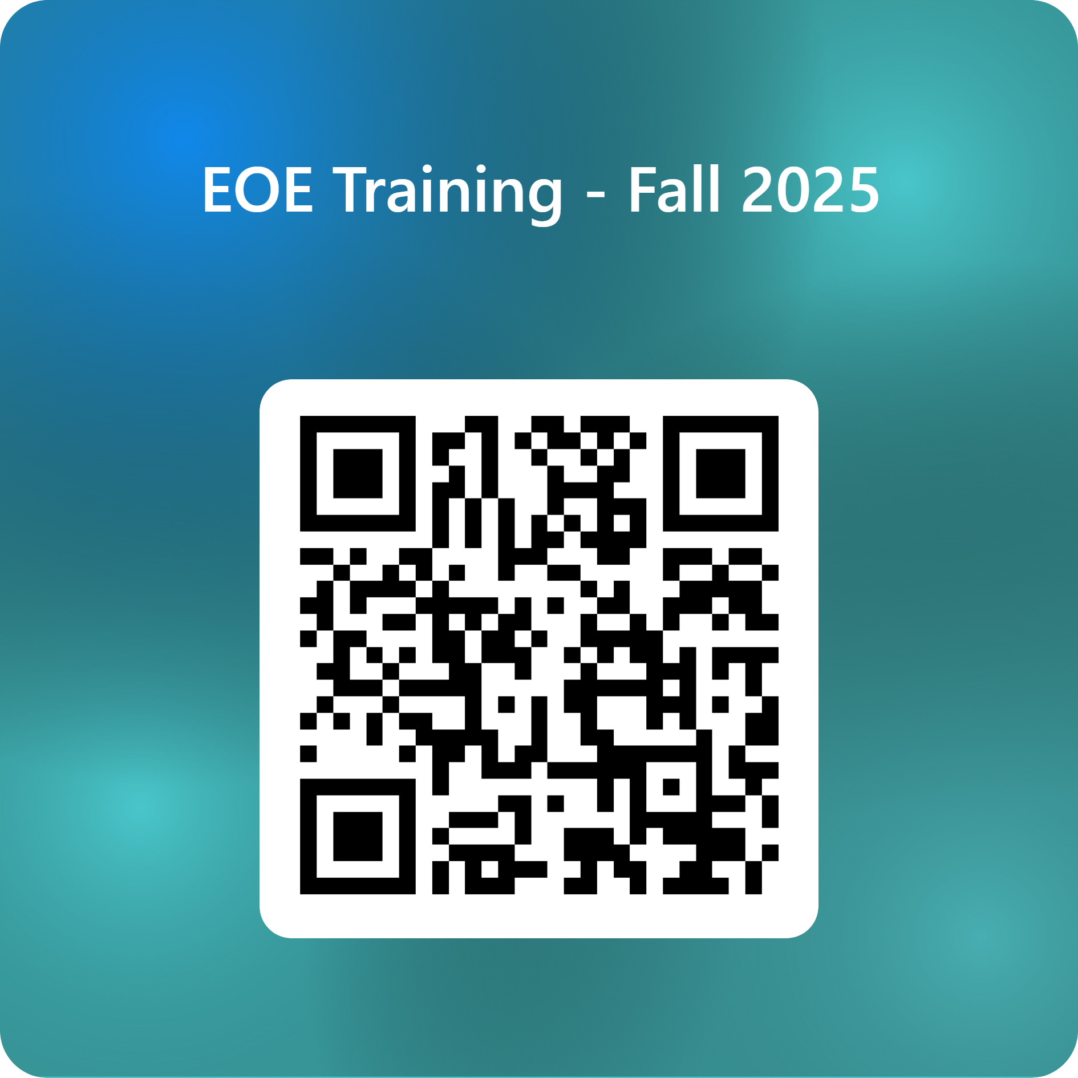
Attendance
Notes:
https://forms.office.com/r/1Pr0WrpTdc

